Slide 1
PARKING MANAGEMENT SYSTEM
BY
ADITYA HOLENNAVAR 2GI18CS009
ADITYA SHANBHAG 2GI18CS010
AKSHAY MARNUR 2GI18CS016

Slide 2
INTRODUCTION
As we know, due to increase in number of cars and limited spots ,parking the cars is getting difficult. In metropolitan cities, car parking has become a major concern in all busy areas, and a good traffic system need a good parking system.
In this project ,we have made a system where it is possible to reserve a parking spot ahead in time as to reduce the need to search parking spots and the unnecessary rush.
This parking lot does not require a parking attendant. It will save a lot our time and it keeps all the records properly.
The system has backup files and the system is secured.

Slide 3
FUNCTIONAL REQUIRMENTS
1.New customers will have to be able to register with parking system so that they can make future reservations.
2. Once a user leaves a spot the spot should become available immediately and not be unavailable till the car exits the garage.
3. If a reserved customer doesn't arrive within the grace period the reservations has to be cancelled but the user will be charged for the full reserved period.
4. When a registered customer wants to make a reservation for aparticular time period then he'll be given a list of dates and time to pick from.
5. System database is considered as the most important functional requirement. It will help the system to store all the important data

Slide 4
NON-FUNCTIONAL REQUIRMENTS
1.parking lot should only permit authorized users to access/edit a customers profile. Customers should not be able to alter their amount owed in any other than posting a payment.
2. Only a valid email address and credit card number should be accepted.
3. Only those customers with an account profile in good standing should be allowed to make a reservation.
4. Parking system should incorporate self- check features to get malfunctioning hardware serviced/replaced to minimize any reduction of service.
5. In terms of data integrity, this parking system will maintain consistence and accuracy of the collected and stored data.

Slide 5
UML DIAGRAMS
CLASS DIAGRAM
ER DIAGRAM
USE CASE DIAGRAM
SEQUENCE DIAGRAM
ACTIVITY DIAGRAM

Slide 6
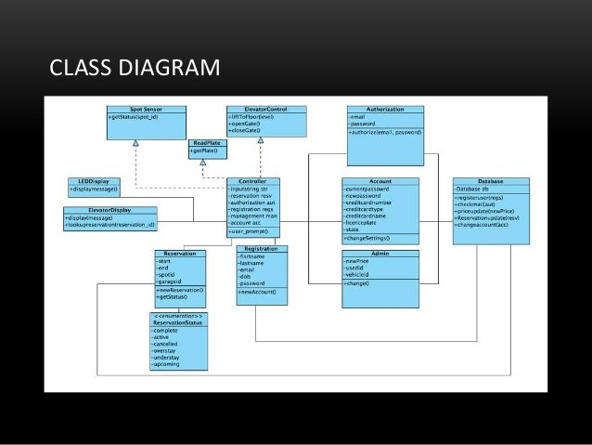

Slide 7
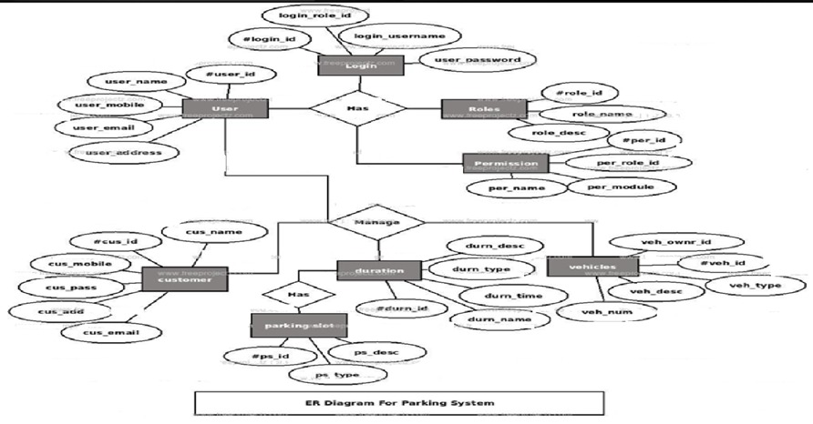
ER DIAGRAM

Slide 8
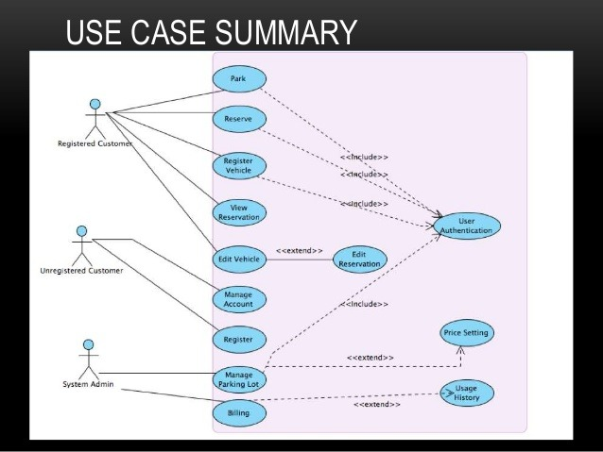

Slide 9
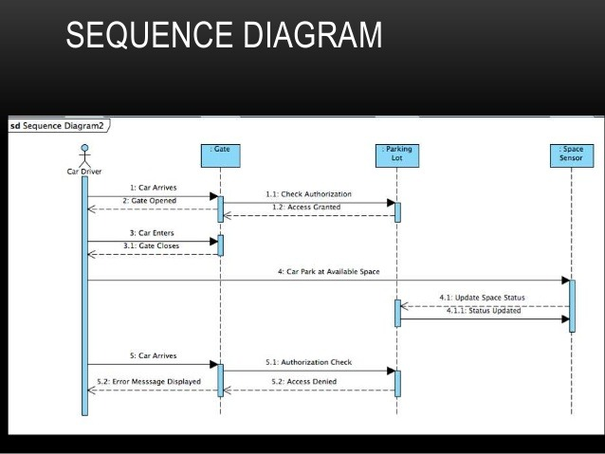

Slide 10
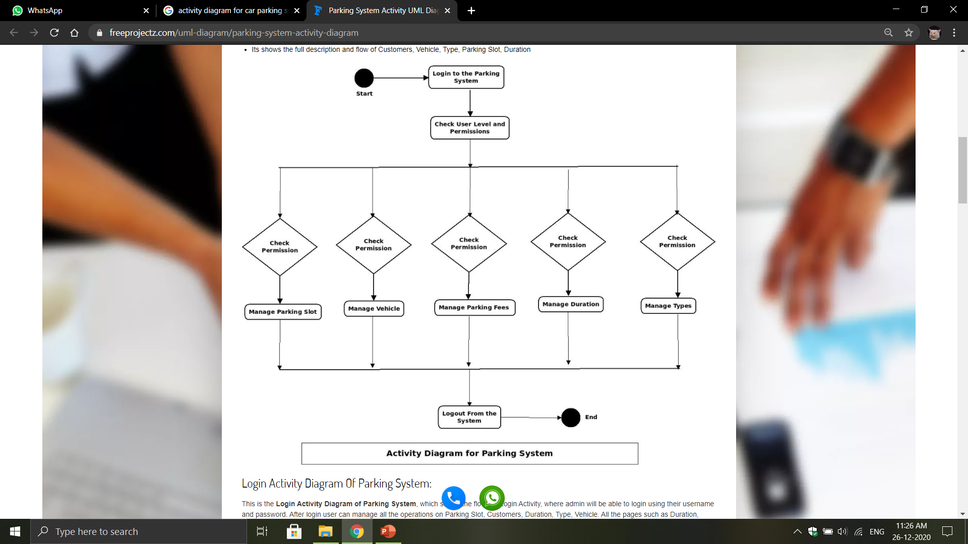
ACTIVIY DIAGRAM

Slide 11
CONCLUSION
Online vehicle parking reservation system improves the existing system since we are in
computerized world. With this new system is mandatory, it enables the user of the system (client,
employee, System administrator) to reserve a parking lot online and this reduces the wasting of
time of the clients looking for where to park, increase the safety of the property since the parking
lot is numbering.

Slide 12
THANK YOU

